Slide 1

Autonomous Helicopter
By
David Mason
Adam Gould
Shaquana Peterson
Edward Budimier
Jens Johnson

Slide 2
Project Description
To create a helicopter which is capable of autonomous: lift-off, point A to B navigation, obstacle avoidance and landing. All within a given environment without crashing.

Slide 3
Management Approach
Communication
Motivation
Scheduling
Feedback

Slide 4
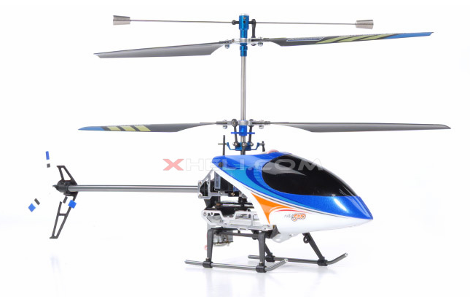
Technical Approach
Flight Control Management
Control System
Sensor Feedback System
Reverse Engineering

Slide 5
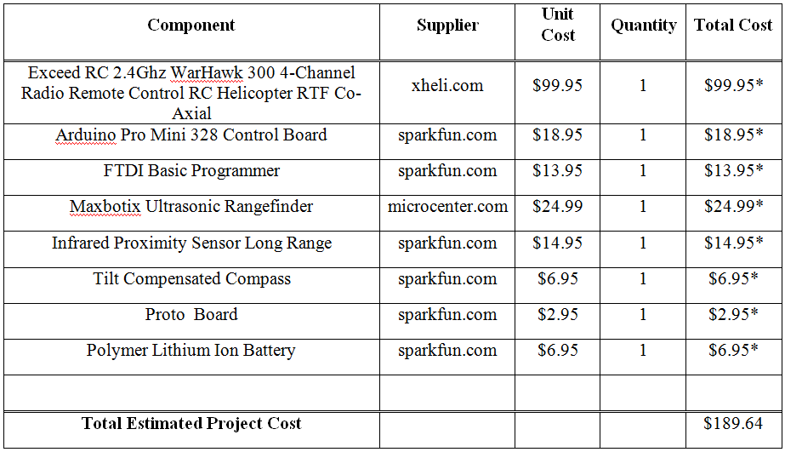
Budget

Slide 6
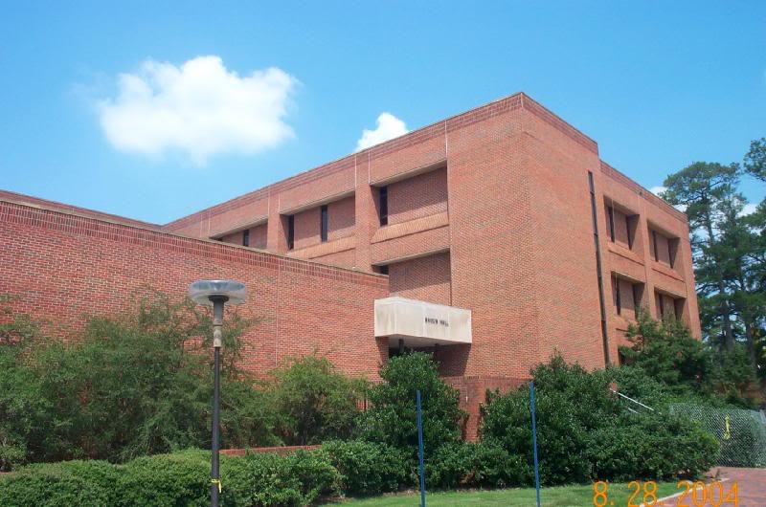
Facilities
The facilities that will be used for the design will be Broun Hall 307 and 238.

Slide 7
Realistic Constraints
Time
Money
Expertise
Payload
Environment

Slide 8
Application of Standards
Sustainability
Manufacturability
Health and Safety
Social Impact
Political Impact

Slide 9
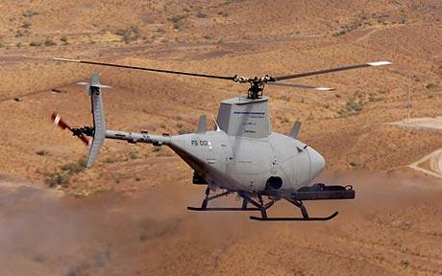
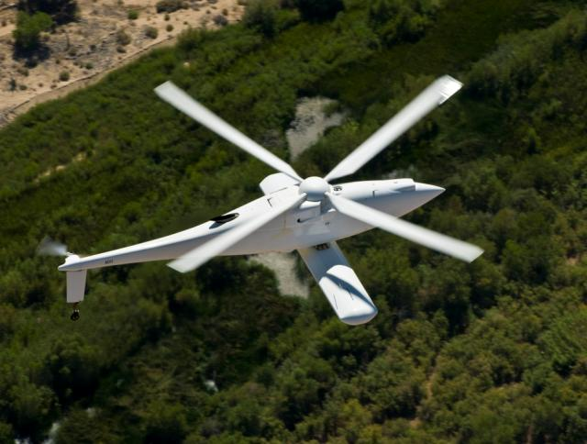
Applications
Scouting
Personal Parcel Delivery
Aerial Surveillance
Delivery of Supplies to Troops
Aerial Combat
Remote exploration of all manner of environments previously unreachable.

Slide 10
Disposition
Any group member wishing to obtain sole ownership of any items previously co-held by the group will provide adequate compensation for such items.
Any remaining unwanted property will be donated to an establishment of our choice.

Slide 11

Thank You!

